Slide 1
Introduction to Machine Learning
Dense Layers

Slide 2



Dense Layers
A Layer is called a Dense Layer, if each of its Neurons is connected to all Neurons of the previous Layer. All neurons in a dense layer have the same activation function.
$$x_{1}$$
$$x_{2}$$
$$x_{3}$$
Input Layer
Layer 0
Layer 1
Layer 2

Slide 3







Formal approach to Dense Layers
In a Dense Layer
weights of all neurons in the layer are written as a matrix
biases of all neurons in the layer are written as a row vector (!)
$$w_{1}$$
$$w_{2}$$
$$w_{z}$$
x
…
+
$$b_{1}$$
$$b_{2}$$
$$b_{z}$$
$$= x⋅W+b$$

Slide 4







A trick to get rid of bias vektor and have a pure linear function:
$$w_{1}$$
$$w_{2}$$
$$w_{z}$$
x
1
…
$$b_{1}$$
$$b_{2}$$
$$b_{z}$$
$$= x⋅W$$
„Dense Layer Matrix“

Slide 5










If we have several feature vectors…
$$x_{1}$$
1
$$w_{1}$$
$$w_{2}$$
$$w_{z}$$
$$x_{2}$$
1
…
$$b_{1}$$
$$b_{2}$$
$$b_{z}$$
$$x_{N}$$
1
Note: Now, the activation needs to be applied. (Not needed, if linear)
$$= X⋅W$$

Slide 6

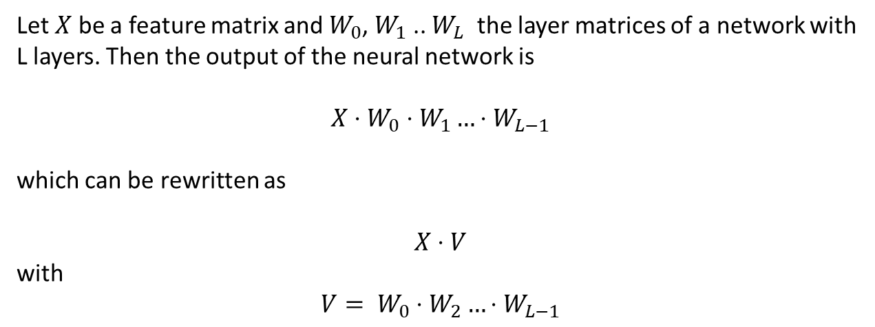
Consequence: A Neural Network with multiple dense layers and a linear activation does not make sense.
Let $X$ be a feature matrix and $W_{0}$, $W_{1}$ .. $W_{L}$ the layer matrices of a network with L layers. Then the output of the neural network is
$$X⋅W_{0}⋅W_{1}…⋅W_{L−1}$$
which can be rewritten as
$$X⋅V$$
with
$$V= W_{0}⋅W_{2}…⋅W_{L−1}$$
So our Network with L layers is not better than using a one layer network with layer matrix $V$!

Slide 7
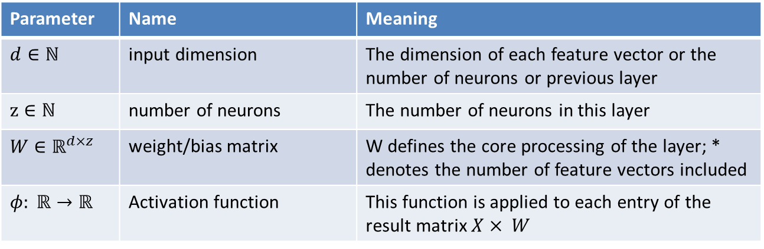
Dense Layer
A Dense Layer at this stage is defined by the following parameters:
Parameter | Name | Meaning
$d∈ℕ$ | input dimension | The dimension of each feature vector or the number of neurons or previous layer
$$z∈ℕ$$ | number of neurons | The number of neurons in this layer
$W$ $∈ℝ^{d×z}$ | weight/bias matrix | W defines the core processing of the layer; * denotes the number of feature vectors included
$$φ: ℝ→ℝ$$ | Activation function | This function is applied to each entry of the result matrix $X× W$

